Slide 1
Data-Driven Customer Decisions
Fei Peng

Slide 2
A
OPPORTUNITY · market scale & where retrieval demand concentrates
China's LLM boom: six scenarios for web-search demand
100T → 140T
5,000+
Scenario
User / buyer
Evidence need & demand driver
Best route
Why this matters (CTO)
Observed: end-2025 -> Mar-2026(trillion tokens)
AI companies (MIIT, Sep 2025)
Product, strategy, VC, consulting
Multi-hop synthesis, broad sources, citations; freshness + hallucination risk
You Research + global web + local fallback
Premium = time saved + fewer bad calls
Deep research
538
APAC
Finance / legal / compliance
Analysts, risk, legal ops
Traceable sources, dates, filings, policy freshness; audit & governance need
You Finance / Research + domain APIs
Citation failure = governance risk
CAC-filed GenAI services (Aug 2025)
Multi-market: language, sources, residency
Enterprise assistant
Platform eng, IT, BUs
Internal KB + external market / legal / news; RAG + enterprise knowledge
Hybrid RAG router (KB + local + global)
Search becomes a shared platform service
Demand driver → web-search-API call
Mode-based search + cache + fallback
Agent automation
Developer platform, AI apps
Low-latency search, retries, cost caps, observability; agent fan-out per step
Reliability > demo quality
Search demand now scales with agents, not only users.
▸ Freshness gap — current policy, market, product.
▸ Hallucination risk — evidence over plausibility.
▸ Agent loops — fan-out, retries, cost/answer.
▸ RAG + KB — internal + external context.
Exporters, global SaaS, cross-border
English / global sources: pricing, policy, competitor, regulatory intel
You global web as premium route
Strongest near-term wedge for China
China-to-Global info
Local consumer Q&A
Consumer apps
Cheap local answers, native Chinese content, commodity
Local search / model-native
Don't force You.com where local suffices
Sources: China NBS / SCMP token-economy report (via TechRadar) · Public China AI ecosystem reports (industry filings, local press) · CAC Interim GenAI Measures (digichina.stanford.edu) · CAC algorithm / model filing records (public registry) · Grand View Research — APAC LLM outlook; Fortune Business Insights · Global Times — National Data Bureau token volume (Mar 2026)
Notes:
Slide 1 source verification - checked 2026-07-17
[VERIFIED OFFICIAL REPORTING] China token volume: more than 140T average daily token calls by late March 2026 versus 100T at end-2025. State Council English site; underlying data attributed to the National Data Administration / National Data Resource Survey Report (2025).
https://english.www.gov.cn/archive/statistics/202604/29/content_WS69f20885c6d00ca5f9a0ab5c.html
[VERIFIED OFFICIAL REPORTING] 5,000+ AI companies: State Council English site, citing MIIT data released at the 2025 World Smart Industry Expo. This is an ecosystem-company count, not an LLM or web-search vendor count.
https://english.www.gov.cn/news/202509/08/content_WS68bec24ac6d0868f4e8f566f.html
[VERIFIED PRIMARY REGULATOR] 538 filed GenAI services: CAC states that 538 services had completed filing as of 2025-08-31, with 263 applications/functions registered.
https://www.cac.gov.cn/2025-09/10/c_1759222982377536.htm
[VERIFIED OFFICIAL REPORTING / CNNIC STUDY] 515M GenAI users as of June 2025, up 266M in six months.
https://english.www.gov.cn/archive/statistics/202510/18/content_WS68f30556c6d00ca5f9a06e05.html
[QUALITATIVE SYNTHESIS] APAC is multi-market across language, source ecosystems and data-residency requirements. It is not presented as a single market-size statistic.
Presenter caution: 100T -> 140T are observed values, not a forecast.

Slide 3
B
BATTLEFIELD · global competitive landscape
Layer | Representative vendors | Strength | Weakness / risk | You.com play
Local search ecosystems | Baidu/Quark/Alibaba/Sogou/Tencent/360/Bing China | Deepest native Chinese index; sub-second latency; mobile & consumer reach | Bundled into their clouds; no clean global-web API; ecosystem lock-in | Use as local fallback & baseline — not a premium wedge
Model-native search | Zhipu/GLM (std,pro,sogou,quark) Kimi/Moonshot Doubao/Qwen/Hunyuan DeepSeek | Purpose-built for LLMs; mature SDKs; cheap; bundled into LLM UX | Opaque retrieval; hard to isolate quality; weaker global/English; cross-vendor governance hard | Benchmark as default; prove where external search changes the answer
Independent / global AI-search APIs | You.com Perplexity Brave Tavily | API-first; global web; developer integration; eval-friendly; RAG-ready; neutral | China access / compliance / latency; procurement localization; SerpApi vs Google lawsuit | Win China-to-Global & APAC-ex-China first
Vertical evidence engines | AlphaSense · FactSet · Bloomberg · Wind (万得) · 北大法宝 · Westlaw · LexisNexis · domain finance/legal APIs | Authoritative domain sources; compliance posture; audit-ready; curated | High cost; narrow use cases; not general agent web search; integration effort | Partner & route for finance & legal — do not replace
Continuous delivery
Continuous service
Continuous bad-case
Continuous optimization
MBR / QBR
▸ Ship eval + router + telemetry as part of the deliverable.
▸ Reference architecture + versioned configs; reproducible eval harness.
▸ Reproducible regression suite for every release.
▸ SLO posture: p50 / p95, timeout, retries, fallback, custom QPS caps.
▸ Data posture: ZDR, retention, DPA, audit trail, status page.
▸ Named TAM + 24×7 incident response & rollback runbook.
▸ Weekly bad-case review: citation failures, stale answers, blocked sources, latency spikes.
▸ Joint triage + root-cause taxonomy; route-override process.
▸ Bad-case bank → eval set → product feedback loop.
▸ Weekly metrics: quality, latency, cost per successful answer.
▸ Route tuning, cache tuning, A/B on retrieval modes; regression guards.
▸ Trend review to catch silent drift before the customer does.
▸ Monthly (MBR): usage, latency, cost, anomalies, quick wins.
▸ Quarterly (QBR): expansion roadmap, ROI review, contract refresh.
▸ Insights feed product roadmap (coverage, latency, governance).
Notes:
SLO Service level object/SLA

Slide 4
C
ACCOUNT ARCHITECTURE · ecosystem and search-demand map
Alibaba centers with various demands
Business unit / product
Primary buyer
Search demand
Alibaba advantage
You.com implication
Quark / local route
▸ Default for China-local commerce and consumer queries.
▸ Alibaba first-party data + native Chinese index.
▸ Lowest-cost route for commodity lookup.
AIDC: Alibaba.com / AliExpress / Lazada
Merchant product / regional GM
Global market, price, policy, competitor and multilingual seller support
Commerce data, workflow and distribution
P0 direct wedge: global Search / Research behind the agent
Alibaba Cloud: Qwen / Model Studio
AI platform / product / engineering
Agent web search, tool calling and enterprise grounding
Qwen, Model Studio and cloud enterprise reach
P0 Strategic partner route; optional premium global evidence
You Search route
▸ Global, multilingual and fresh structured web.
▸ AIDC, Cainiao and DingTalk agent lookup.
▸ Premium only where coverage changes the outcome.
DingTalk enterprise agents
Enterprise AI / product
Internal Knowledge Base plus fresh external market, legal and news context
Collaboration, admin control and enterprise distribution
P1 Hybrid RAG connector: KB + local + global
Logistics network and first-party operating data
You Research route
Cainiao global logistics
Operations / risk / control tower
Customs, carriers, sanctions, trade rules and disruption intelligence
P2 monitoring / alert pilot with global evidence
▸ Multi-hop, citation-sensitive synthesis.
▸ Strategy, legal, compliance and market-entry research.
▸ Measure supported answers and decision time saved.
Taobao / Tmall / 1688 / Quark
China commerce / search product
Domestic product, merchant, Chinese web and consumer content
Deep local index, ecosystem data and consumer reach
P3 Local primary; only global or citation-sensitive exceptions
Domain evidence route
▸ Finance, legal, logistics and authority sources.
▸ Route Wind / FactSet / Westlaw and domain APIs as needed.
▸ Compose with web evidence; do not replace.
Group strategy / legal / compliance
Strategy, legal ops and risk
Filings, regulation and market research
Internal context and access to authority sources
P3 Premium Research + licensed evidence; lower volume, high value
Sources: Alibaba Group FY2025 annual report and public business pages · Alibaba Cloud Model Studio / Qwen, DingTalk, AIDC and Cainiao public materials · You.com API documentation · Buying-center map is a discovery hypothesis.

Slide 5
D
Web Search Integration Strategy & Evaluation Framework
Leveraging You.com Open-Source Harness for LLM Grounding
Experiment: You.com leads grounded search-chain quality; GLM leads latency.
Web Search Results
HalluQA Search-Chain Comparison
Evaluation Harness Architecture
Temporal rule: any '2026 event has not happened' rejection requires human review.
88%
60%
Metric
You.com
GLM Quark
Core reuse
Dataset, BaseSampler, async runner
You.com + Qwen
GLM Quark + Qwen
V2 risk
14.2%
17.5%
Provider paths
You.com, GLM Quark, Qwen opt-in adapters
V2 severe
5.8%
5.8%
English factual QA
English factual QA
V2 safe
85.8%
82.5%
Fixed controls
120 bilingual cases; Top-5 explicit chains
Answerable useful
62.9%
45.7%
Dual judge
V1 behavior + V2 provider-evidence grounding
42%
98-100%
Evidence coverage
100.0%
98.3%
Qwen-only
(forced)
Chinese QA
Evidence supported
76.7%
73.3%
Reliability
timeout, retry, 429 cooldown, heartbeat, batches
Technical failure
1.7%
5.0%
Black-box baseline
Saturated set
Product p50
6.31 s
5.45 s
Auditability
raw CSV, logs, manifest, error_stage, 31 tests
Evidence available: You.com 120/120; GLM Quark 118/120;Quark is not stable
Harness extension, not a greenfield rewrite
Strategic Recommendation:Multi-provider
Next Plan: Operationalize Evaluation Outcomes
Prioritize You.com for grounding-critical workloads
Best current balance of hallucination risk, answer utility, and pipeline reliability.
Grounding Validity Optimization
Cost & ROI Benchmarking
Use GLM Quark selectively for latency-sensitive traffic
Lower p50 latency, with stronger reliability and fallback controls required.
Schema repair
Tokens, calls, unit economics, vendor rank
High-Stakes Case Review
DECISION CONFIDENCE
Position Qwen for exploratory, low-consequence experiences
low-risk creative scenarios
Double-label critical + 2026-sensitive cases
Set production thresholds by use case
Build policy-based multi-provider routing
Route by factual risk, latency, availability, and unit economics
Routing Policy Iteration
Evaluation System Expansion
Various web search services
Chinese cases, new vendors, regression suite

Slide 6
E
ACCOUNT CONVERSION + OPERATING MODEL | buy -> launch -> expand
Alibaba wins with a governed route, not a one-time API sale
1 BUYING COMMITTEE
2 STAGE-GATED CONVERSION
3 OPERATE + EXPAND
Four approvals run in parallel
Prove the gap workload; do not sell replacement
Continuous service is the revenue engine
Business sponsor
Funds pilot; owns KPI and outcome
1 DISCOVER
2-3 gap workloads + accountable owner
WEEKLY
Bad-case clinic -> patch route / prompt
2 BASELINE
Accepted Quark / Qwen baseline + bad cases
MBR
Success, cost/success,, errors -> improvement
AI / platform
API fit, SLO, telemetry, fallback
3 SHADOW
Dual-route, no user impact, threshold defined
QBR
Value, risk, roadmap -> renew / expand
Security / legal
Data scope, transfer basis, retention
4 CANARY
Fallback, compliance and telemetry proven
Procurement / finance
Cost per success, terms, continuity
REVENUE EXPANSION
5 PRODUCTION
Route policy, budget and owner approved
1 LAND
One workload + one BU
2 PROVE
SLO + ROI + governance
CLOSE GATE
ROUTE THESIS
3 EXPAND
Adjacent teams / query classes
Named sponsor + production owner + approved data route + budget / capacity plan
Quark stays the China-local default. You.com earns global-web and citation-sensitive traffic. Qwen native answer remains in the product mix.
4 PLATFORM
Shared gateway / group contract
You.com role: eval -> route -> operate -> expand
Customer evidence + governance cadence + measured expansion | Alibaba data policy stays a production gate
Notes:
Slide 1 source verification - checked 2026-07-17
[VERIFIED OFFICIAL REPORTING] China token volume: more than 140T average daily token calls by late March 2026 versus 100T at end-2025. State Council English site; underlying data attributed to the National Data Administration / National Data Resource Survey Report (2025).
https://english.www.gov.cn/archive/statistics/202604/29/content_WS69f20885c6d00ca5f9a0ab5c.html
[VERIFIED OFFICIAL REPORTING] 5,000+ AI companies: State Council English site, citing MIIT data released at the 2025 World Smart Industry Expo. This is an ecosystem-company count, not an LLM or web-search vendor count.
https://english.www.gov.cn/news/202509/08/content_WS68bec24ac6d0868f4e8f566f.html
[VERIFIED PRIMARY REGULATOR] 538 filed GenAI services: CAC states that 538 services had completed filing as of 2025-08-31, with 263 applications/functions registered.
https://www.cac.gov.cn/2025-09/10/c_1759222982377536.htm
[VERIFIED OFFICIAL REPORTING / CNNIC STUDY] 515M GenAI users as of June 2025, up 266M in six months.
https://english.www.gov.cn/archive/statistics/202510/18/content_WS68f30556c6d00ca5f9a06e05.html
[QUALITATIVE SYNTHESIS] APAC is multi-market across language, source ecosystems and data-residency requirements. It is not presented as a single market-size statistic.
Presenter caution: 100T -> 140T are observed values, not a forecast.
telemetry：可观测数据，也就是系统运行时留下的监控和诊断信息。
客户会想知道：
每次调用花了多久？
是哪个 search route？
有没有 timeout？
有没有 fallback？
返回了几个 sources？
citation 是否为空？
失败原因是什么？
成本是多少？
哪个业务线调用最多？
哪些 query 最容易失败？

Slide 7
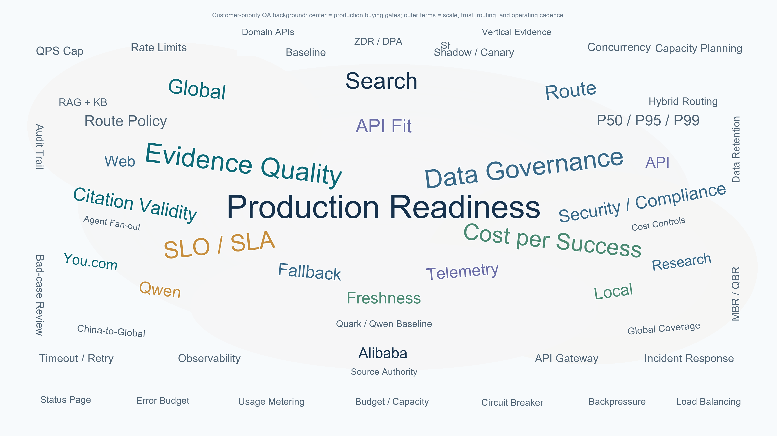
Notes:
稳定性
API 会不会经常失败、超时、返回空结果。
延迟
P50 / P95 / P99 latency 是否能满足 agent 或产品体验。
SLO / SLA
服务质量有没有目标或承诺，比如可用性、错误率、响应时间。
Fallback
You.com 出问题时，是否能自动切到 Quark / Qwen / 本地搜索，不影响用户。
Telemetry
有没有日志和监控，可以看到调用量、失败率、延迟、成本、fallback 次数、bad cases。
安全与合规
数据会不会被保存、是否跨境、是否可审计、是否符合客户的数据政策。
成本控制
有没有 QPS cap、budget cap、usage metering，避免 agent 大量调用导致费用失控。
事故响应
出问题时谁负责、多久响应、怎么回滚、怎么复盘。

